Slide 1

Cuda Accelerated implementation of Traveling Salesman Problem using Genetic Algorithms (TSP-GA)
Chris Rumsey
rumsey@Arizona.edu
Joel Maldonado
Joelmaldonado@arizona.edu
Chris

Slide 2
ABSTRACT
This project explores GPU-accelerated approaches to solving the Traveling Salesman Problem, a classic optimization challenge where the goal is to find the shortest possible route through a set of cities. Starting from a Python baseline, the project builds and compares a sequential C genetic algorithm, a naive CUDA implementation, and more advanced CUDA genetic algorithm variants. Numerous approaches to optimizes the CUDA implementation, with specific focus on the tour length calculation were explored. The main focus is understanding how GPU parallelism, memory layout, and reduced CPU-GPU communication can improve performance while preserving solution quality.

Slide 3

Background – Traveling salesman
Traveling salesman is a canonical NP hard problem in computer science, attempting to find a Hamiltonian circuit in an undirected digraph. This is to say find The that minimizes path length. This is a tour tour that visits each node exactly once starting and finishing in the same place and minimizes the distance traveled.
While humans are intrinsically good at finding
solutions to this problem, the combinatorial
explosion of city combinations means that a
computer algorithm will struggle find good results.
However, applicable to CUDA, the problem is
Embarassingly Parallelizable. Even with this trait the sheer magnitude of the issue means that
some more advanced technique is needed.

Slide 4
Background-genetic algorithms
Genentic algorithms imitate biology in computation and it is usually used for hard problems that have some structure that can be exploited. It encodes solutions of a problem as Genes.
A population of genes is initialized. Usually randomly.
Then these Genes are mutated and crossed/mixed according to different heurisitics.
Then a reduction/Natural selection phase comes in where genes are
Evaluated and best genes are picked.
These selection of Genes is then used as seeds for the next generation and algorithm repeats.
In our case we encode as the genes: solutions/torus of the traveling salesman problem.

Slide 5
Background-genetic algorithms
In our case we encode as the genes: solutions/torus of the traveling salesman problem.
We initialize random sequences of tour traversal as our initial population

Slide 6
Design challenge – cuda specific
While Genetic Algorithms are an easily parallelable in theory, there are many design challenges to consider:
Where and how to represent the candidate populations in memory
How to communicate between blocks to allow cross mutation
How to store the distance matrix to facilitate tour distance evaluation
Tuning the GA numbers to

Slide 7
Basic tsp solver for cuda
The most basic approach involves writing a very greedy algorithm which simply chooses the closest neighbor from the current node and creates a tour in this fashion iteratively
This tour is of course not very good, but it does generate a useful heuristic to feed an elite population member to the Genetic algorithm portion.
This tour was evaluated using the GPU kernel, and tuned and optimize, since the fitness evaluation function will be called very often.

Slide 8
Basic ga for cuda
After implementing fitness evaluation the next step is to get the most simple form of Genetic Algorithms running in a parallel fashion, giving a basis for further optimization.

Slide 9
Optimization idea 1 - coalesing
Memory coalescing was optimized by reorganizing tour data so that neighboring CUDA threads access neighboring memory addresses at the same tour step. Instead of storing each tour contiguously and causing strided reads across a warp, the population can be transposed so city positions are grouped together across tours. This allows a warp to fetch consecutive city indices in fewer memory transactions, reducing global memory bandwidth waste and improving fitness-evaluation throughput.
Results!
Graphs!
Tables!

Slide 10
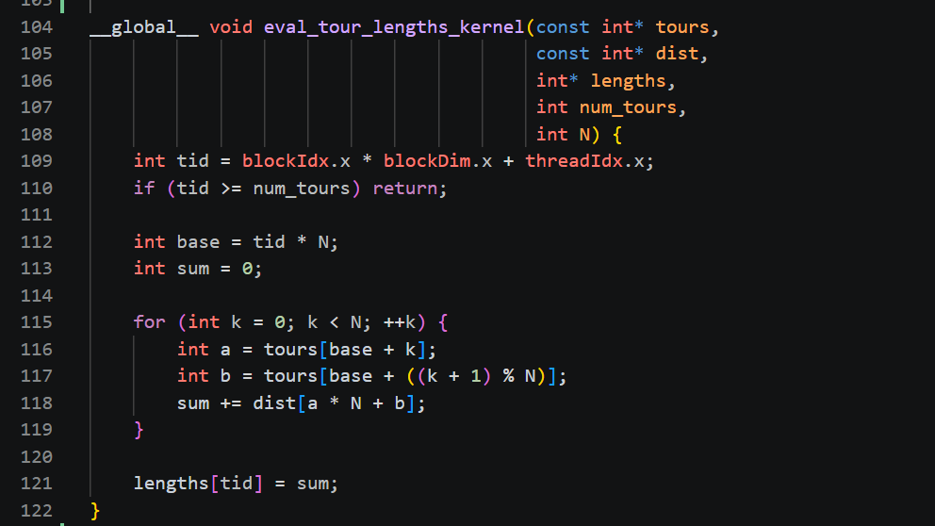

Slide 11
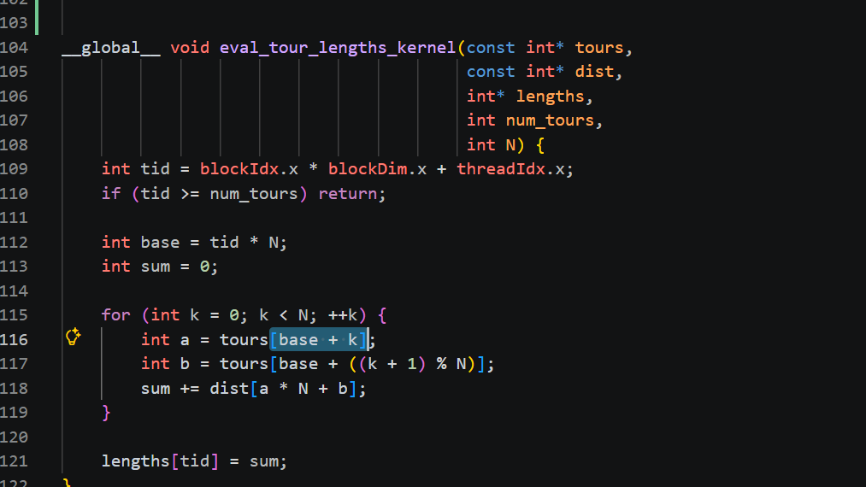

Slide 12
Optimization idea 2 – opt 2
2-opt can be used as a local improvement step to refine tours produced by the genetic algorithm. After crossover and mutation create a candidate route, 2-opt checks whether reversing a segment of the tour would remove crossing edges and shorten the total distance. This helps the GA converge faster by improving solution quality within each generation, though it must be applied selectively in CUDA because exhaustive 2-opt searches can add significant computation and memory-access overhead.
Results!
Graphs!
Tables!

Slide 13
Optimization idea 3 – Memory Bank ConflicT
Shared Memory is organized in Banks. Our GPU P100 has 32 memory banks each 4 bytes wide. The pattern of memory access : pop_a[t * n + k] with n = 128
Has the property of being multiple of 32. So each time we are hitting the same memory bank.
Every thread in the warp hits the same bank at the same instruction, provoking a 32-way bank conflict. The hardware serializes these 32 accesses into 32 sequential transactions. We want to avoid this serialization
Results!
Graphs!
Tables!

Slide 14
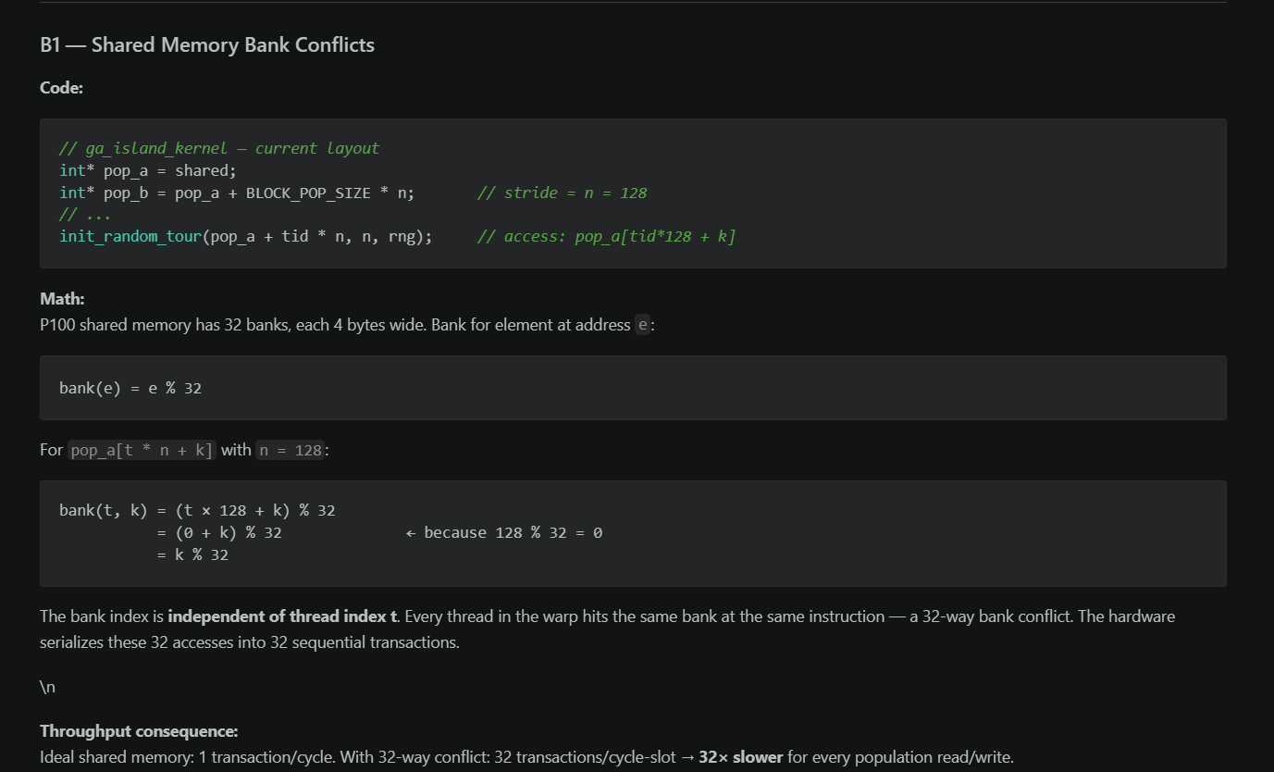

Slide 15
Conclusion and overall results
Placeholder Results and Conclusions
At this stage, the reported results are preliminary and should be treated as placeholders. The project has established the baseline implementations and identified several promising CUDA optimization techniques, including improved memory coalescing, GPU-resident population evolution, and possible 2-opt local search improvements. However, these optimizations have not yet been fully implemented, benchmarked, or validated.
The current conclusion is that CUDA offers strong potential for accelerating the Traveling Salesman genetic algorithm, especially in the fitness-evaluation stage where many tours can be processed in parallel. Future work will focus on implementing the proposed optimizations, measuring their effect on runtime and solution quality, and comparing the optimized GPU versions against the sequential and naive CUDA baselines.
Results!
Graphs!
Tables!

Slide 16
Questions?

